Slide 1
Smart DUSTBIN

Slide 2
Need:
When these smart bins are implemented on a large scale, by replacing our traditional bins present today, waste can be managed efficiently as it avoids unnecessary lumping of wastes on roadside.
Foul smell from these rotten wastes that remain untreated for a long time, due to negligence of authorities and carelessness of public may lead to long term problems.
Breeding of insects and mosquitoes can create nuisance around promoting unclean environment. This may even cause dreadful diseases

Slide 3
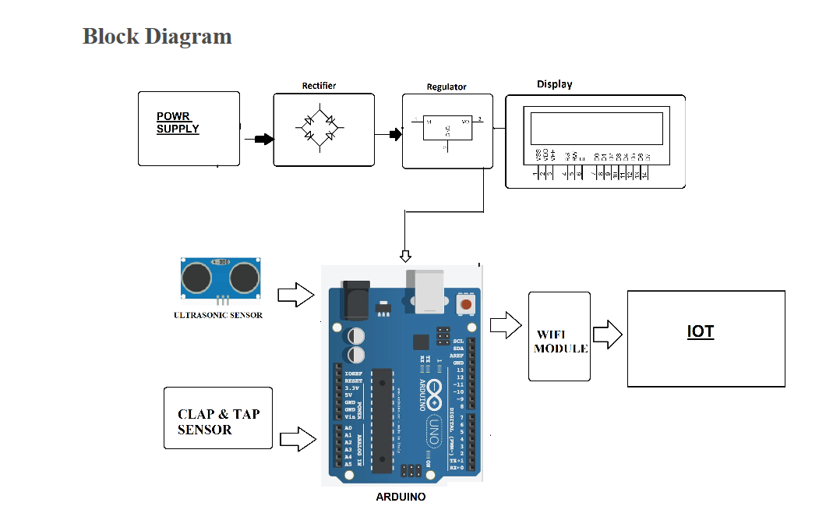
Sample Diagram:

Slide 4
Why ARDUINO
Arduino boards are able to read analog or digital input signals from different sensors and turn it into an output such as activating a motor or led etc.
We can control your board functions by sending a set of instructions to the microcontroller on the board via Arduino IDE.
Unlike most previous programmable circuits boards, Arduino does not need an extra piece of hardware in order to load a new code onto the board. You can simply use USB cable.

Slide 5
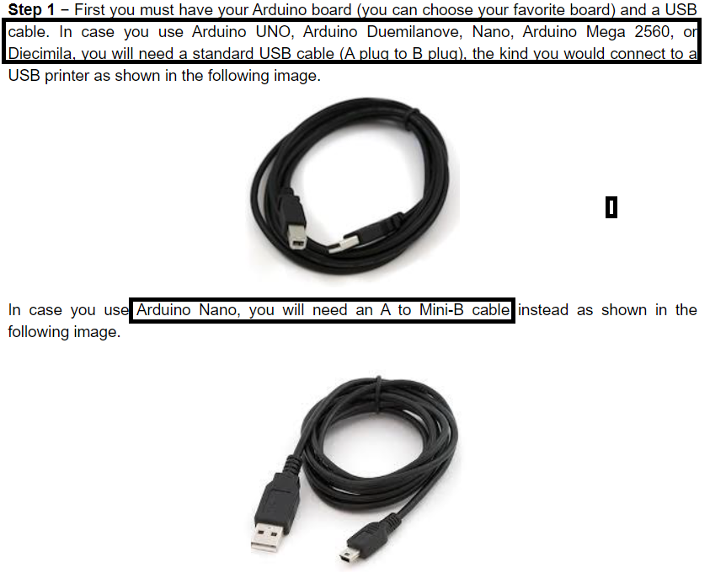

Slide 6
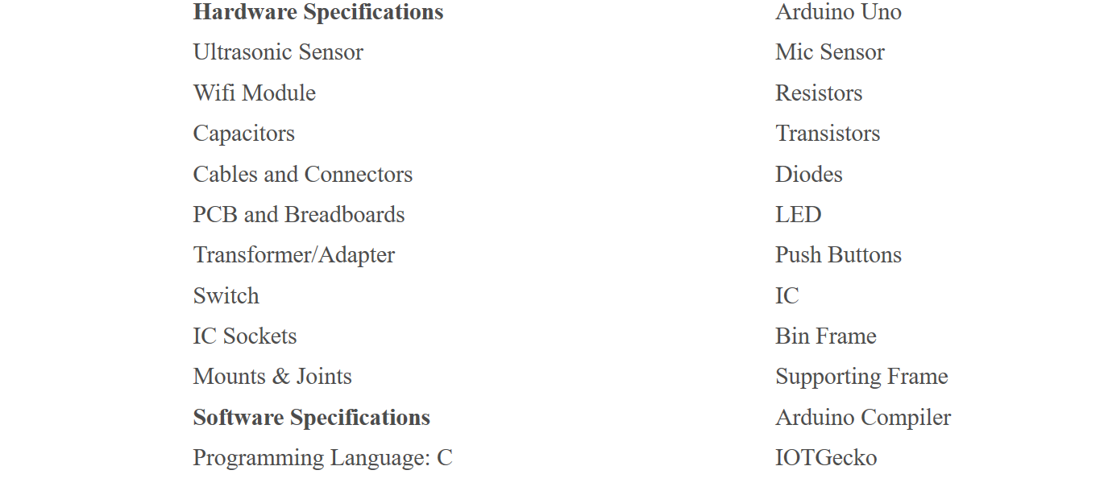
Requirements:

Slide 7
Ultrasonic sensor – 100/-https://www.amazon.in/HC-SR04-Ultrasonic-Distance-Measuring-Arduino/dp/B01LXFUAFV?tag=yhoabhsep18-21&tag=yhooinkenshoo-21&ascsubtag=f54e82c6-f0c5-46f4-b2d2-a2b57a564a8c
Ardunio Uno – 519/- https://www.flipkart.com/revert-mart-arduino-uno-r3-atmega328p/p/itmefz3fpsd8tgca?pid=ETYEFZ3FQ3ESQUSF&lid=LSTETYEFZ3FQ3ESQUSFGTXP71&marketplace=FLIPKART&cmpid=content_learning-toy_F116BPYB_bmc_pla&tgi=sem,1,G,11214002,o,search,,{creative},{adposition},e,,c,{devicemodel},,{placement},{target},{aceid},,&s_kwcid=AL!739!3!{creative}!e!{placement}!o!4579740809586919!&ef_id=XSmhjAAAAG_0hn6l:20191006061240:s
GSM module - 280/- https://www.flipkart.com/revert-mart-arduino-uno-r3-atmega328p/p/itmefz3fpsd8tgca?pid=ETYEFZ3FQ3ESQUSF&lid=LSTETYEFZ3FQ3ESQUSFGTXP71&marketplace=FLIPKART&cmpid=content_learning-toy_F116BPYB_bmc_pla&tgi=sem,1,G,11214002,o,search,,{creative},{adposition},e,,c,{devicemodel},,{placement},{target},{aceid},,&s_kwcid=AL!739!3!{creative}!e!{placement}!o!4579740809586919!&ef_id=XSmhjAAAAG_0hn6l:20191006061240:s
Bluetooth module 369/- https://www.flipkart.com/epro-labs-bluetooth-module-hc-05/p/itmeggsdgn8gddzz?pid=ETYEGGSDEP7JYKCU&lid=LSTETYEGGSDEP7JYKCU40AYXL&marketplace=FLIPKART&cmpid=content_learning-toy_F116BPYB_bmc_pla&tgi=sem,1,G,11214002,o,search,,{creative},{adposition},e,,c,{devicemodel},,{placement},{target},{aceid},,&s_kwcid=AL!739!3!{creative}!e!{placement}!o!4579740809586919!&ef_id=XSmhjAAAAG_0hn6l:20191006063918:s
Li-ion rechargeable batteries
Solar panel – 122/- https://www.flipkart.com/electronic-spices-6v-100ma-wire-attached-solar-panel/p/itmfhwybdbnk7thn?pid=SLPFHTTKBPKVHSGV&srno=s_1_4&otracker=search&otracker1=search&lid=LSTSLPFHTTKBPKVHSGVQY3XOO&fm=SEARCH&iid=e4c76995-64ed-493e-bf8f-d7dc9347a735.SLPFHTTKBPKVHSGV.SEARCH&ppt=sp&ppn=sp&ssid=a655pjnkzqr1hu681570344106798&qH=eed516e6e1d92fc4

Slide 8
Sample Code:
#include <Servo.h> //servo library
Servo servo;
int trigPin = 2;
int echoPin = 3;
int servoPin = 9;
long duration, dist, average;
long aver[3];
void setup() {
servo.attach(servoPin);
pinMode(trigPin, OUTPUT);
pinMode(echoPin, INPUT);
servo.write(0); //close dustbin cap on power on
delay(1000);
servo.detach();
}
void measure() {
digitalWrite(trigPin, LOW);
delayMicroseconds(5);
digitalWrite(trigPin, HIGH);
delayMicroseconds(15);
digitalWrite(trigPin, LOW);
pinMode(echoPin, INPUT);
duration = pulseIn(echoPin, HIGH);
dist = (duration/2) / 29.1; //obtain distance
}
void loop() {
for (int i=0;i<=2;i++) { //average distance
measure();
aver[i]=dist;
delay(50); //delay between measurements
}
dist=(aver[0]+aver[1]+aver[2])/3; //average distance by 3 measurements
if ( dist<40 ) {
//if hand on the distance 10...50 cm
servo.attach(servoPin);
delay(1);
servo.write(90);
delay(5000); //wait 5 seconds
servo.write(0);
delay(1000);
servo.detach();
}
}

Slide 9




Target AUDIENCE
Non-Govt Org.
Government
National Solid Waste Association of India (NSWAI)
INDIANS

Slide 10
Additional IDEAS
Tracking nearby DUSTBIN
Getting notified directly on Smartphones.
Alert given to particular organization is however more accurate when it gives direct notification to appropriate organization like NSWAI about the public dustbins in nearby areas.

Slide 11
Resources
https://create.arduino.cc/projecthub/msr048/smart-dustbin-064003
https://nevonprojects.com/smart-dustbin-with-iot-notifications/

Slide 12
https://innovate.mygov.in/innovation/smart-dustbin/

